Slide 1
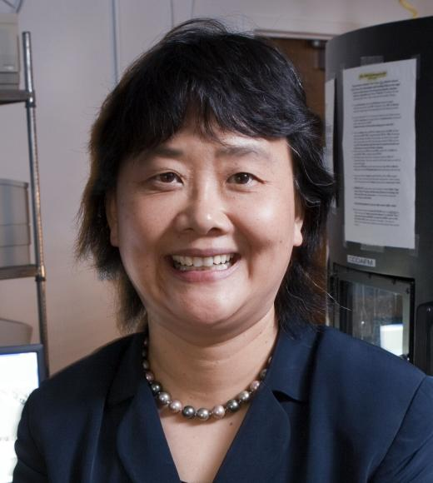
Gang-yu Liu
Notes:
# Name Gang-yu Liu # Textbook Knight, College Physics: A Strategic Approach, 2nd Edition, Chapter 28, section 8 Knight, Physics for Scientists and Engineers: A Strategic Approach with Modern Physics, 3rd Edition, Chapter 5 # Contributors # Description Gang-yu Liu is a chemist and professor at the UC Davis. She graduated from Beijing University and received her M.A. and Ph.D. degree from Princeton University by 1992. Her research is focused on development of nanotechnology and potential applications to bioanalytical chemistry ("Gang-yu Liu", 2017). To investigate the cancer cell signaling and allergy, she has used high resolution images taken by AFM (Atomic Force Microscopy) and published papers about her research on nanostructures of ligands and receptors.Through her research using AFM, the method for nanografting for determining the orientation and packing of biomolecules on surfaces has been developed significantly. Also, her research on nanotechnology and bioanalytical chemistry has been expected to have a potential for medical and biological applications ranging from medicines to fundamental studies of molecular biology. Based on her fabulous work on nanolithographic methods, she got several awards including Career Development Chair Award, Wayne State University (2000-2001), Outstanding Scholarly Achievement Award, Wayne State University (2000), NSF CAREER Award (1997-2001), Arnold and Mabel Beckman Young Investigator Award (1996-1998), and Camille and Henry Dreyfus New Faculty Award (1994-1999). # Sources Gang-yu Liu. (2017, Oct 5). Retrieved from https://chemistry.ucdavis.edu/people/gang-yu-liu Nanografting for Surface Physical Chemistry. (2017, Nov 19). Retrieved from https://pdfs.semanticscholar.org/79dc/1a5846db51048144e2a7d912202d827ffa4e.pdf # Photo https://chemistry.ucdavis.edu/sites/g/files/dgvnsk196/files/styles/sf_profile/public/images/person/Liu-Gangyu.jpg?h=7c1d8cc5&itok=91BsutFA

